Slide 1

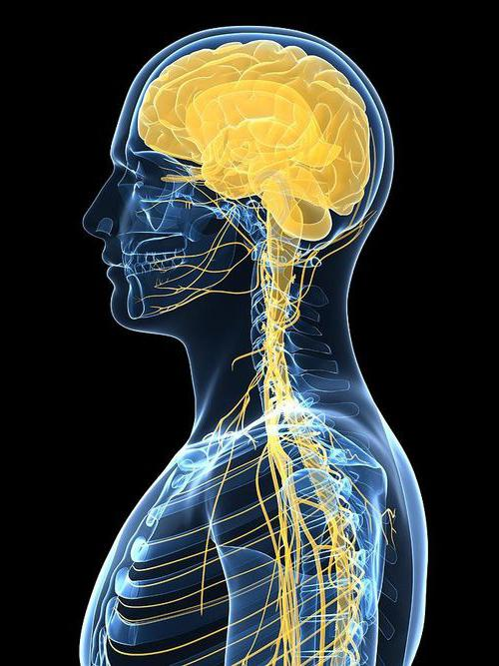
КАФЕДРА УКРАЇНСЬКОЇ ТА ІНОЗЕМНИХ МОВ
Професійна комунікація іноземною мовою
у менеджменті неврологічних дисфункцій
ДИСЦИПЛІНА ВІЛЬНОГО ВИБОРУ
для здобувачів вищої освіти
денної і заочної форм навчання
ІV року навчання
ВК.ФТ 39

Slide 2

Any Anatomy book states that…
Our nervous system coordinates all of the activities in your body – from breathing or digesting food to sensing pain or feeling fear.
The brain, spinal cord, and nerves work together.
Nerves transmit messages back and forth to every organ, tissue, and cell.
In this course we suggest getting in more detail!

Slide 3
Here are few essential things we suggest studying during this course!
Basic Vocabulary

Slide 4
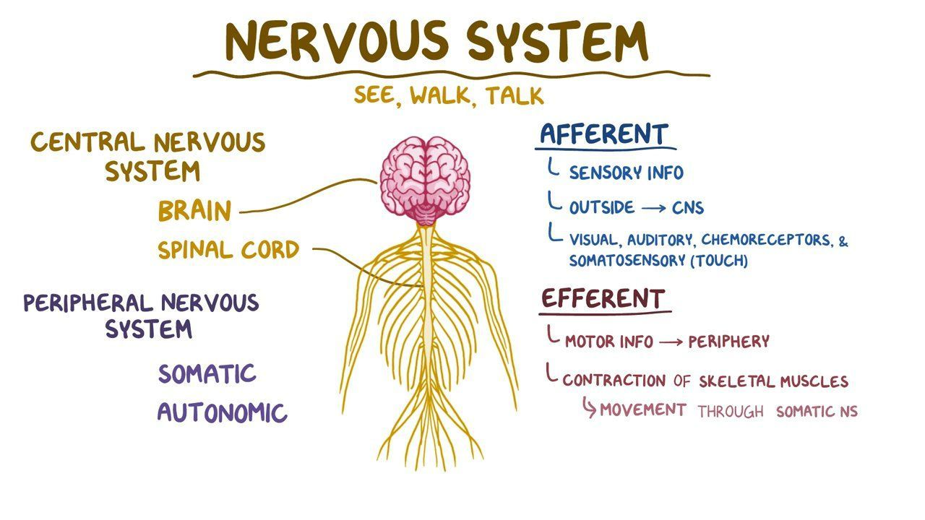
2) General concepts:
functions, locations,
anatomy
3) Real-life application

Slide 5
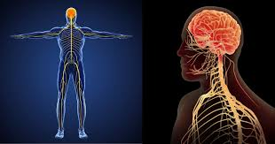
… or in other words this is HOW IT WORKS!
LEARN and PRACTISE
English in a live class!
Thus, you will get to
know more about:
So, you will
discuss how…
central nervous system
peripheral nervous system
medical specialists in this area
care and problems of central nervous system
care and problems of peripheral system
career opportunities in this area

Slide 6

Here are just a few printed course recourses that we use during our classes. Have a look!
However, there are much more if you count the Internet resources!

Slide 7


Some communicative competences you shall develop!
Differentiate between the central nervous system and the peripheral nervous system.
Identify the structure and function of neurons.
Describe the areas of the brain and the function of each.
Demonstrate knowledge and research more about personal health concerns related to the nervous system.
Examine the effects of health behavior on the nervous system.
Identify different types of head and spinal cord injuries.
Describe different diseases and disorders of the nervous system.

Slide 8

Join our classes
and
master your Professional English!

